Slide 1
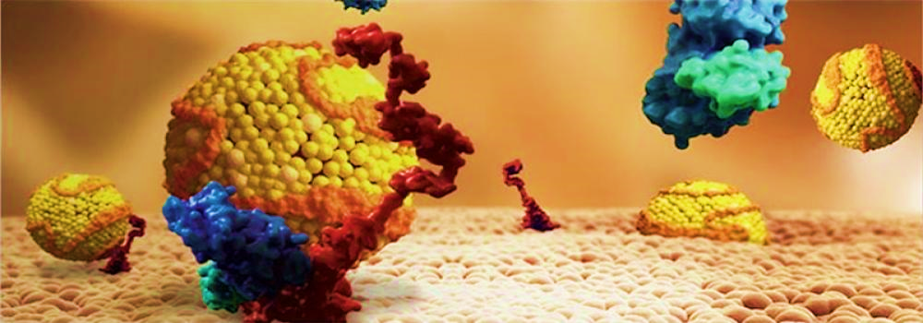

New Horizons in Dyslipidemia Management in Primary Care

Slide 2

Presenter Disclosure
Presenter - [presenter name]
Relationships with commercial interests:
Grants/Research Support:
Speakers Bureau/Honoraria:
Consulting Fees:
Patents:
Other:

Slide 3
Disclosure of Commercial Support
This program has received financial support from Amgen Canada in the form of an educational grant.
This program has received in-kind support from Amgen Canada in the form of logistical support.
Potential for conflict(s) of interest:
[Presenter] has received [payment/funding, etc.] from [organization supporting this program AND/OR organization whose product(s) are being discussed in this program].
Amgen Canada developed, licenses, distributes and benefits from the sale of a product that will be discussed in this program

Slide 4
Mitigating Potential Bias
The Canadian Heart Research Centre assesses conflict of interest with its instructors, planners, managers and other individuals who are in a position to control the content of CME activities. All relevant conflicts of interest that are identified are thoroughly vetted by the CHRC for fair balance, scientific objectivity of studies utilized in this program, and patient care recommendations. The CHRC is committed to providing its learners with high quality CME activities and related materials that promote improvements or quality in healthcare and not a specific proprietary business interest of a commercial interest.
The speaker had provided a full disclosure in advance of the program. The scientific content of the program is evidence based and all content related to pharmacotherapy is within product label. The program has been peer reviewed and is nationally accredited by the College of Family Physicians of Canada.
[Presenter] has provided his disclosure information at the start of this presentation.

Slide 5
Accreditation Statement
This one-credit-per-hour Group Learning program has been certified by the College of Family Physicians of Canada and the Provincial Chapter for up to X Mainpro+ credits.

Slide 6

Program Development
This program was planned by the Canadian Heart Research Centre, a not-for-profit academic organization to achieve scientific integrity, objectivity, and balance.
This program has received an educational grant and in-kind support from Amgen Canada

Slide 7
Steering Committee
Lawrence A. Leiter, MD, FRCPC, FACP
Chair
Division of Endocrinology and Metabolism
St. Michael’s Hospital
Professor of Medicine and Nutritional Sciences
University of Toronto
Robert Dufour, MD, MSc
Associate Director, IRCM Clinic
Director, Nutrition, Metabolism and Atherosclerosis Clinic
Assistant Clinical Professor, Department of Nutrition
Université de Montréal
Shaun Goodman, MD, MSc, FRCPC, FACC, FAHA, FESC
Associate Head, Cardiology, St. Michael's Hospital
Consultant, Canadian Heart Research Centre
Professor and Heart & Stroke Foundation of Ontario (Polo) Chair, Department of Medicine, University of Toronto
Jean C. Grégoire, MD, FRCP(c), FACC
Interventional Cardiologist
Institut de cardiologie de Montréal
Associate Professor
Université de Montréal
Jeffrey Habert, MD
Family Physician Assistant Professor
University of Toronto
Dept. of Family and Community Medicine Toronto, Ontario
Peter Lin, MD
Family Physician Director Primary Care Initiatives
Canadian Heart Research Centre
University of Toronto
G. B. John Mancini, MD, FRCPC, FACP, FACC
Department of Medicine, Division of Cardiology
Research Director, Division of Cardiology
Director, Cardiovascular Imaging Research Core Laboratory (CIRCL)
Professor of Medicine
University of British Columbia
Daniel Ngui, MD
Family Physician Clinical Lead, Fraser Street Medical
Clinical Associate Professor
UBC Department of Family Medicine Vancouver, British Columbia

Slide 8
Learning Objectives
Upon completion of this activity, participants will be able to:
01
Discuss the role of LDL-C lowering in cardiovascular risk reduction with emphasis on the results of recently completed clinical trials
02
Evaluate recommendations for lipid lowering agents beyond or in addition to statin therapy for patients with atherosclerotic cardiovascular disease
03
Explain the mechanism of action of proprotein convertase subtilisin/kexin type 9 (PCSK9) inhibitors and apply the latest clinical data to patient management strategies
04
Apply best guideline practice recommendations into routine clinical practice based on specific patient characteristics

Slide 9

What Proportion of Patients Achieve LDL-C Target < 2 mmol/L on Statin Therapy?
Please select from one of the available options
50% or less
60%
70%
Over 80%
Notes:
Correct Answer: 50% or less

Slide 10
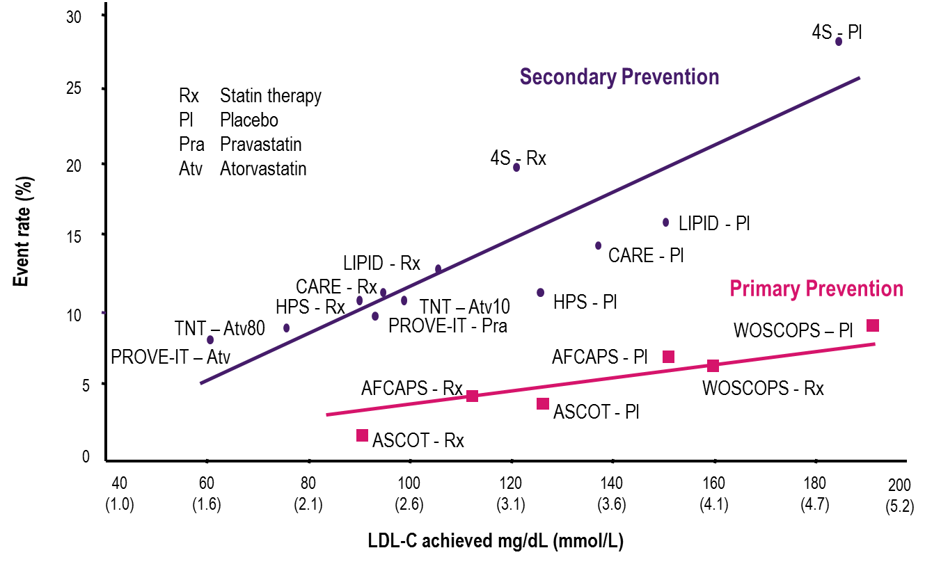

Relationship Between
LDL-C and CV Event Rate
Rosenson RS. Exp Opin Emerg Drugs 2004;9(2):269-279, LaRosa JC et al. N Engl J Med 2005;352:1425-1435.

Slide 11
Reduction in CV Events is Proportional to LDL-C Reduction at 1 Year
A prospective meta-analysis of data from 90,056 individuals from 14 trials of statins
A 1 mmol/L reduction in LDL-C was associated with a…
23% reduction in major coronary events
21% reduction in major vascular events
50
50
40
40
30
30
Proportional reduction in event rate (%±SE)
Proportional reduction in event rate (%±SE)
20
20
10
10
0
0
0.5 (19)
1.0 (38)
1.5 (58)
2.0 (77)
0.5 (19)
1.0 (38)
1.5 (58)
2.0 (77)
-10
-10
Reduction in LDL-C mmol/L (mg/dL)
Reduction in LDL-C mmol/L (mg/dL)
Adapted from Baigent C, et al, Cholesterol Treatment Trialists’ (CTT) Collaborators. Lancet 2005;366:1267–1278.

Slide 12

On-Statin LDL-C Levels and Risk for Major Cardiovascular Events
There is often a need for LDL-C reduction beyond statin therapy
1.00
40
0.75
30
In clinical trials, even amongst those patients on a similar statin dosage, those who had the lowest LDL-C levels had the lowest CV event rates
HR for Major CV Events (―)
Percent of Patients ( %)
0.50
20
0.25
10
0
1.3
2.6
3.9
5.2
6.5
Achieved On-statin LDL Levels
Meta-analysis of 8 statin trials (N=38,153):
>40% did not reach LDL-C target (<1.8 mmol/L) on high dose statin
CV, cardiovascular; CVD, cardiovascular disease; HR, hazard ratio.
Boekholdt SM et al. J Am Coll Cardiol. 2014;64:485-494.

Slide 13
Many High-Risk Canadian Patients Treated with Statins Are Not at LDL-C Goal
DYSIS¹
Canadian high-risk patients are NOT at LDL-C target^{1*} (< 2.0 mmo/L)
88% of patients received a ‘potent’ statin with suboptimal dose
14% of patients received additional lipid-lowering agent
45%
DM-SCAN²
Canadian patients with diabetes are NOT at LDL-C target† (≤ 2.0 mmo/L)
82% of patients were on a lipid-lowering agent
43%
*High risk = coronary artery disease, peripheral arterial disease, cerebrovascular disease, diabetes mellitus or Framingham 10-year risk score ≥20%. DYSIS Study – 2,436 patients, 1913 high risk patients.
†N = 5,069
1. Goodman SG et al. on behalf of the DYSIS Canadian Investigators. Can J Cardiol. 2010;26:e330-e335. 2. Leiter LA et al. on behalf of the DM-SCAN investigators. Can J Diabetes. 2013;37:82-89.

Slide 14
Limitations of Current Lipid-Lowering Therapies
1970’s
1980’s
1990’s
2000’s
2010’s
0%
Fibrates
Niacin
BAS
Ezetimibe
-10%
-20%
Statins
1st Generation
IMPROVE-IT
-20%
-20%
-20%
LDL-C Lowering (%)
Statins
2nd Generation*
-40%
-40%
reduction on top of statin with addition of ezetimibe
-20%
-60%
-60%
BAS: Bile Acid Sequesterant
1. The Coronary Drug Project Research Group. JAMA. 1975;231:360-81; 2. Lipid Research Clinics Program. JAMA. 1984;251:351-64; 3. Frick MH et al. N Engl J Med. 1987;317:1237-45; Vaughan CJ, 4. Gotto AM Jr. Circulation. 2004;110:886-92; IMPROVE-IT Investigators. N Engl J Med. 2015;372:2387-97. 5. National Institute for Health and Clinical Excellence. London: National Institute for Health and Clinical Excellence, 2012.
Notes:
Notes:
2015
Clofibrate and niacin in coronary heart disease. JAMA. 1975;231(4):360–381; The Lipid Research Clinics Coronary Primary Prevention Trial results. I. Reduction in incidence of coronary heart disease. JAMA 1984;251(3):351-64; Frick MH, Elo O, Haapa K, Heinonen OP, Heinsalmi P, Helo P, Huttunen JK, Kaitaniemi P, Koskinen P, Manninen V. Helsinki Heart Study primary-prevention trial with gemfibrozil in middle-aged men with dyslipidemia. N Engl J Med. 1987; 317: 1237–1245; National Institute for Health and Clinical Excellence. NICE technology appraisal guidance 132. London: National Institute for Health and Clinical Excellence; 2007. Ezetimibe for the treatment of primary (heterozygous-familial and non-familial) hypercholesterolaemia. Available from: http://guidance​.nice​.org.uk/TA132/Guidance/pdf/English; Vaughan, Carl J.; Gotto, Jr., Antonio M. "Update on Statins: 2003". Circulation. 2004; 110: 886-892

Slide 15
Why May Statin Therapy Not Be Sufficient?
Please select from one of the available options
Efficacy of statin therapy
Side-effects
Variability of individual patient response
All of the above
Notes:
Correct Answer: All of the above

Slide 16
Why is Statin Treatment Not Enough?
Side-effects such as statin associated muscle symptoms reported in 10% to 25%
Wide range of individual responses to statins
Limited ability to lower LDL-C
Real-world data from the GOAL Program showing the need beyond statin use
Bruckert et al 2005; Cohen et al 2012

Slide 17
Prevalence of Statin Associated Muscle Symptoms (SAMS) in PRIMO
Retrospective observational + high-dose statin
Statin | Dosage | Percentage of patients with muscular symptoms* | Odds Ratio† [95% CI] | P value‡
Pravastatin | 40 mg/day | 10.9%
Atorvastatin | 40–80 mg/day | 14.9% | 1.28 [1.02–1.60] | 0.035
Simvastatin | 40–80 mg/day | 18.2% | 1.78 [1.39–2.29] | <0.0001
Fluvastatin | 80 mg/day | 5.1% | 0.33 [0.26–0.42] | <0.0001
*% values relative to the total number of patients with or without muscular symptoms. † Odds ratios were calculated using pravastatin as the reference. ‡ P values were determined by Pearson’s Chi-squared test.
PRIMO: Prediction of Muscular Risk in Observational conditions
Bruckert E et al. Cardiovasc Drugs Ther. 2005 ;19: 403–414

Slide 18
Large Individual Variability in LDL-C Reduction with Atorvastatin 10 mg
Men
Women
0
0
-10
-10
-20
-20
-30
-30
Percent LDL-C change
Percent LDL-C change
-40
-40
-50
-50
-60
-60
-70
-70
Patients with familial hypercholesterolemia
Pedro-Botet J, et al. Atherosclerosis 2001; 158(1):183-93.
Notes:
Notes:
In this study of patients with familial hypercholesterolemia, there is a very large variability in the reduction of LDL-C to atorvastatin 10 mg.
Reference:
Pedro-Botet J, Schaefer EJ, Bakker-Arkema RG, et al. Apolipoprotein E genotype affects plasma lipid response to atorvastatin in a gender specific manner. Atherosclerosis 2001; 158(1):183-93.

Slide 19
If The Statin Dose Is Doubled, LDL-C Will Be Reduced By An Additional?
Please select from one of the available options
6%
10%
12%
15%
Depending on the statin
Notes:
Correct Answer: 6%

Slide 20
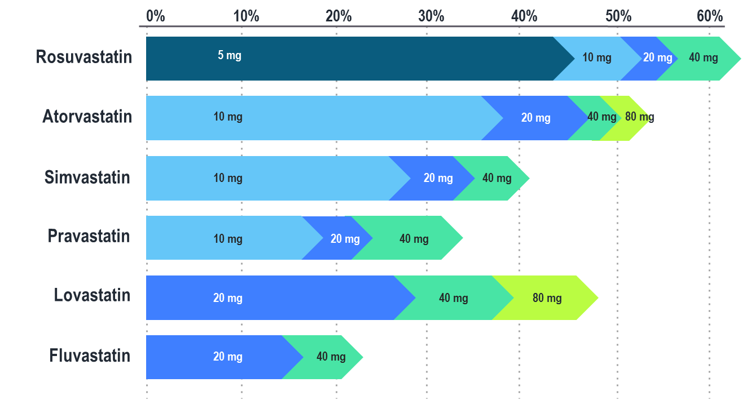
Even Maximal Statin Therapy May Not Be Sufficient In Achieving LDL-C Target
Doubling the statin dose results in only 6% additional LDL-C reduction
*As per Canadian Product Monographs
Crestor (rosuvastatin) Product Monograph. AstraZeneca. April 21, 2015.
Lipitor (atorvastatin) Product Monograph. Pfizer. Feb 18, 2016.
Pravachol (pravastatin) Product Monograph Bristol-Myers Squibb Canada. Nov 30, 2015.
Mevacor (lovastatin) Product Monograph. Merck. Jul. 24, 2012.
Zocor (simvastatin) Product Monograph. Merck. Dec 10, 2014.
Lescol (fluvastatin) Product Monograph. Novartis. Aug. 26, 2016.
Adapted from CURVES Investigators. Am J Cardiol. 1998;81:582-587.

Slide 21

Guideline Oriented Approach to Lipid lowering in Canada (GOAL)
The GOAL Program is an ongoing real-world designed and coordinated by the Canadian Heart Research Centre
The GOAL Program is evaluating the management of patients at high-risk, defined as those with clinical atherosclerotic cardiovascular disease, and an LDL-C >2.0 mmol/L despite maximal tolerated statin therapy
The program incorporates a mechanism to support decision making and choice of therapy in order to assist physicians in achieving the Canadian Cardiovascular Society guideline-recommended LDL-C targets in high risk patients.
The interactive program has 3 distinct components:
Capture of data as reported by the physician based on LDL-C lowering strategies at each visit.
Feedback on potential opportunities for LDL-C lowering based on CCS guidelines.
Identification of challenges and reasons faced by physicians (continuation of the care gap).

Slide 22
GOAL: Co-Morbidities
Co-morbidities in high-risk patients (defined as those with clinical atherosclerotic cardiovascular disease) and LDL-C > 2.0 mmol/L despite maximal tolerate statin therapy
N = 1,571 patients
Medical History | Percent of Patients
Coronary artery disease | 51%
Cerebrovascular disease | 8%
Abdominal aortic aneurysm | 2%
Peripheral arterial disease | 9%
Diabetes | 36%
Treated hypertension | 61%
Chronic kidney disease | 8%
Familial hypercholesterolemia | 46%
March 28, 2018 - data cut CHRC file

Slide 23
GOAL: Lipid Profile and Management
N = 1,571 patients
Lab Values | Mean ± std | Median (IQR)
Total cholesterol (mmol/L) | 5.5±1.4 | 5.2 (4.4, 6.2)
LDL-C (mmol/L) | 3.3±1.2 | 3.0 (2.4, 3.9)
HDL-C (mmol/L) | 1.3±0.4 | 1.2 (1.0, 1.5)
Non HDL-C (mmol/L) | 4.1±1.5 | 3.8 (3.1, 4.9)
March 28, 2018 - data cut CHRC file

Slide 24
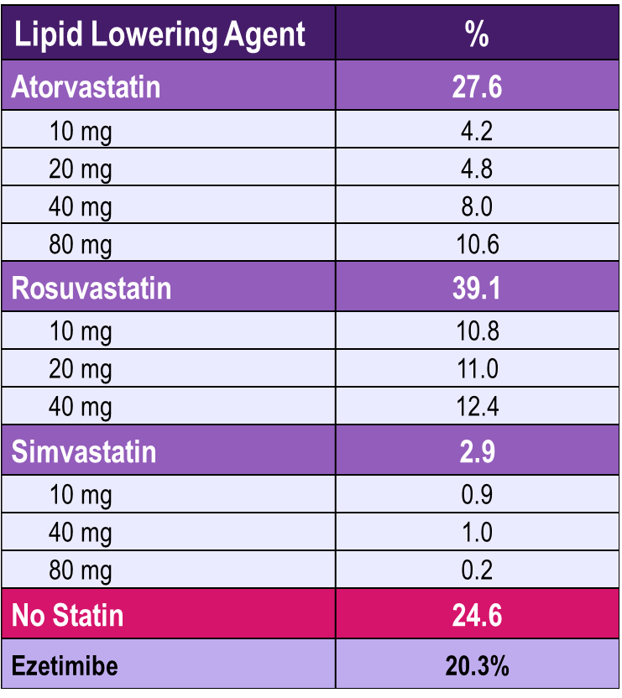
GOAL: Lipid Profile and Management
N = 1,571 patients
March 28, 2018 - data cut CHRC file

Slide 25
Can LDL-C Lowering be Achieved Safely and Effectively with PCSK9 Inhibitors?
Please select from one of the available options
Only if ezetimibe is used as well
Only if ezetimibe is not used
Only if maximal statin therapy is not used
Only in statin intolerant patients
None of the above
Notes:
Correct Answer: None of the Above

Slide 26
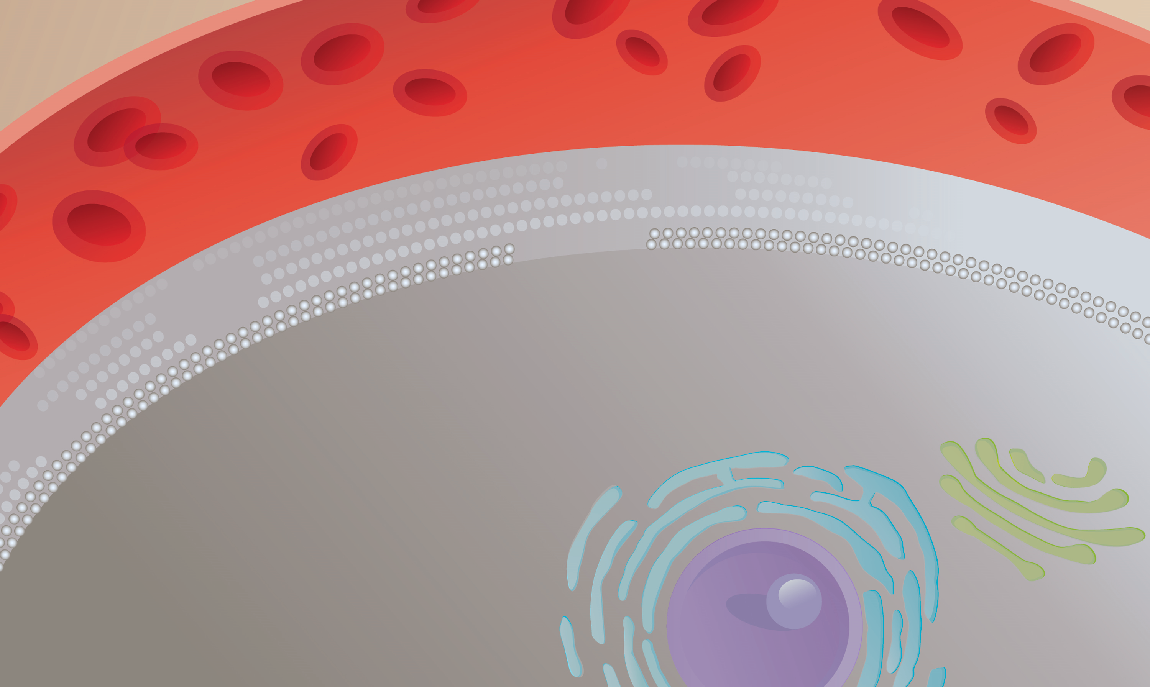
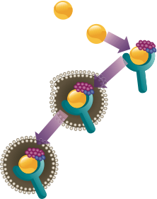
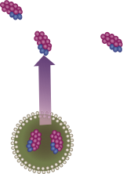

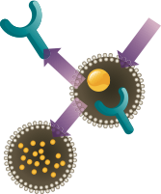
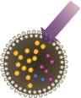

Serum LDL-Cholesterol Binds to LDL-Receptors. Following Internalization, LDL is Degraded and the Receptor Recycled
In the Presence of PCSK9, the LDL-R Is Degraded and Does Not Cycle Back to Cell Surface
LDL
Plasma
PCSK9
LDL
LDL-R
LDL-R
Endocytosis
Hepatocyte
PCSK9
Self-procession
Endocytosis
Endosome
LDL-R
Recycling
Endosome
LDL Degradation
Golgi
Apparatus
Endoplasmic Reticulum (ER)
LDL, LDL-R and
PCSK9 Degradation
Nucleus
Qian YW, et al. J Lipid Res. 2007;48:1488-1498; Horton JD, et al. J Lipid Res. 2009;50(suppl):S172-S177.
Notes:
Speaker Notes:
Hepatocytic LDL receptors bound to LDL particles are delivered to endosomes, where they disassociate from their LDL particles and are returned to the hepatocyte surface; LDL particles continue to the lysosomes for degradation.
Extracellular PCSK9 binds to the LDL receptor at the cell surface. The LDL receptor/PCSK9 complex is internalized by endocytosis and directed to the lysosomes, where the LDL receptor is degraded instead of being recycled back to the cell surface.
Extracellular PCSK9 effectively reduces the number of LDL receptors present on the hepatocyte surface, which consequently increases plasma LDL-C levels.
References:
Qian YW, et al. Secreted PCSK9 downregulates low density lipoprotein receptor through receptor-mediated endocytosis. J Lipid Res. 2007;48:1488-1498.
Horton JD, et al. PCSK9: a convertase that coordinates LDL catabolism. J Lipid Res. 2009;50(suppl):S172-S177.
Seidah NG, et al. PCSK9: a key modulator of cardiovascular health. Circ Res. 2014;114(6):1022-36.

Slide 27
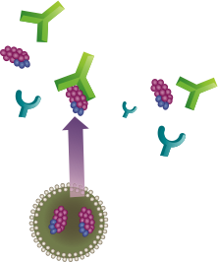

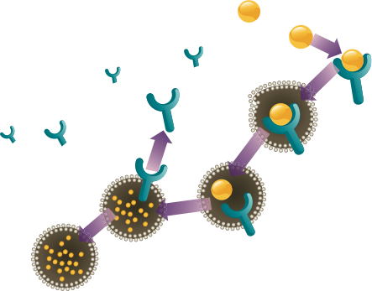
Monoclonal Antibody binds to PCSK9 and inhibits Binding to the LDL-Receptor
Blocking PCSK9 Activity Inhibits Intracellular Degradation of LDL-R
PCSK9 MAb
Plasma
LDL
LDL-R
LDL-R
Recycling
Endocytosis
Hepatocyte
PCSK9
Self-procession
Endosome
Lyosome
LDL
Degradation
Golgi
Apparatus
Endoplasmic Reticulum (ER)
Nucleus
Qian YW, et al. J Lipid Res. 2007;48:1488-1498; Horton JD, et al. J Lipid Res. 2009;50(suppl):S172-S177.
Notes:
Speaker Notes:
Inhibition of PCSK9, e.g. by an antibody, reduced the degradation of LDL receptors, thereby increasing LDL-receptor levels, which allowed for more uptake of LDL from the circulation and decreased plasma LDL-C.

Slide 28
Loss-of-function Mutations for PCSK9 are Associated with Lower Serum LDL-C and Lower Incidence of CHD
LDL-C Levels
Rate of Cardiovascular Disease
3.6
9.7%
P < 0.0001
P = 0.008 for the reduction
HR, 0.11
95% CI, 0.02 to 0.81
P = 0.03
2.6
Coronary Heart Disease (%)
Mean LDL-C Level (mmol/L)
1.2%
No PCSK9 Mutation
PCSK9 –ve Mutation
PCSK9^{142X} or PCSK9^{679X}
No PCSK9 Mutation
N=3278
PCSK9 -ve Mutation
N=85
Lifetime exposure to lower LDL results in dramatic reduction in CV rates
PCSK9^{142X} or PCSK9^{679X}
Cohen JC, et al. N Engl J Med. 2006;354:1264-1272.
Notes:
Notes:
In the ARIC study, a cohort of African-Americans with a loss of function mutation for PCSK9 that was associated with mean LDL-C levels on average 28% lower than the remainder of the study population was associated with an 88% lower lifetime risk for CVD.
This study is important for 2 reasons. Firstly, it validated inhibition of PCSK9 as a target for drug development. Secondly, the much greater than expected CV risk reduction than that observed in the typically 3-5 yr duration statin trials highlights the value of a LIFETIME reduction in LDL-C.
Reference: ARIC Study

Slide 29
Additional LDL-C Reduction Observed With The Addition Of A PCSK9 Inhibitor
Alirocumab 75 mg
Q2W
Alirocumab 75/150 mg
Q2W
Alirocumab 150 mg
Q2W
Evolocumab 140 mg
Q2W
Evolocumab
420 mg
QM
Heterozygous Familial Hypercholesterolemia
Clinical ASCVD
Praluent (alirocumab) Canadian Product Monograph. April 11, 2016.
Repatha™ (evolocumab) Canadian Product Monograph. June 29 2016.
Notes:
Notes:

Slide 30
Evolocumab Cardiovascular Outcomes Trial: Study Population
FOURIER: Further cardiovascular OUtcomes Research with PCSK9 Inhibition in subjects with Elevated Risk
Screening
Age 40-85 years
MI, Stroke or PAD
Additional risk factors (one major or two minor)
Optimal background lipid therapy (including effective dose of statin ± ezetimibe)
LDL-C ≥ 1.81 mmol/L or non HDL-C ≥ 2.59 mmol/L
Randomization 1:1
Evolocumab SC
140 mg Q2W or 420 mg QM
(per subject preference)
n ~ 13,750
End of Study (EOS)
Placebo SC
Q2W or QM
(per subject preference)
n ~ 13,750
Maximum approximately 15 weeks
D1
W4
W12
W24
Q24W
Number of key 2○
endpoints
Background lipid-lowering therapy
Patients must be on an optimized lipid-lowering regimen (moderate to high intensity statin +/- ezetimibe)
In general, patients are not to change open-label background lipid-lowering therapies after randomization
Sabatine MS, et al . N Engl J Med 2017; 376:1713-1722
Notes:
Notes:

Slide 31
FOURIER
Median LDL-C Levels Over Time
2.6
2.4
2.2
Placebo
Median 2.38 mmol/L
2.0
1.8
1.6
59% mean reduction (95% CI 58-60), P < 0.001
Absolute reduction: 1.45 mmol/L (95% CI 1.43-1.47)
1.4
LDL Cholesterol (mmol/L)
1.2
1.0
0.8
Evolocumab
Median 0.78 mmol/L
0.6
0.4
0.2
0.0
0
4
12
24
36
48
60
72
84
108
120
132
144
156
168
No. at risk
Weeks
Placebo
13,779
13,251
13,151
12,954
12,596
12,311
10,812
6,926
3,352
790
Evolocumab
13,784
13,288
13,144
12,964
12,645
12,359
10,902
6,958
3,323
768
LDL-C was significantly reduced in the evolocumab group (median: 0.78 mmol/L) including 42% who achieved levels ≤ 0.65 mmol/L vs < 0.1% in the placebo group
Data shown are median values with 95% confidence intervals in the two arms; ITT. Sabatine MS, et al . N Engl J Med 2017; 376:1713-1722
Notes:
Notes:

Slide 32
FOURIER
Composite of CV Death, MI, Stroke, Hospitalization for UA, or Coronary Revascularization
16
Primary Endpoint
14.6
14
Placebo + SOC
12
10.7
12.6
10
Evolocumab + SOC
Cumulative Incidence (%)
8
9.1
6.0
6
4
5.3
2
0
0
6
12
18
24
30
36
No. at Risk
Months
Placebo
13,780
13,278
12,825
1
1,871
7,610
3,690
686
Evolocumab
13,784
13,351
12,939
12,070
7,771
3,746
689
HR 0.85 (95% CI 0.79 to 0.92); P < 0.001
CV = Cardiovascular; MI = Myocardial infarction; UA = Unstable angina; HR = Hazard ratio; SOC = Standard of Care Sabatine MS, et al . N Engl J Med 2017; 376:1713-1722
Notes:
Notes:

Slide 33
FOURIER
Composite of CV Death, MI, or Stroke
11
Key Secondary Endpoint
9.9
10
9
Placebo + SOC
8
6.8
7
7.9
6
Cumulative Incidence (%)
Evolocumab + SOC
5
3.7
5.5
4
3
2
3.1
1
0
0
6
12
18
24
30
36
No. at Risk
Months
Placebo
13,780
13,449
13,142
12,288
7,944
3,893
731
Evolocumab
13,784
13,501
13,241
12,456
8,094
3,935
724
HR 0.80 (95% CI 0.73 to 0.88); P < 0.001
CV = Cardiovascular; MI = Myocardial infarction; UA = Unstable angina; HR = Hazard ratio ; SOC = Standard of Care Sabatine MS, et al . N Engl J Med 2017; 376:1713-1722
Notes:
Notes:

Slide 34
FOURIER Landmark Analysis of Primary Endpoint
Year 1: RRR 12%
> Year 1: RRR 19%
10%
Hazard ratio 0.88
(95% CI, 0.80-0.97)
10%
Hazard ratio 0.81
(95% CI, 0.73-0.89)
Placebo + SOC
8%
8%
6%
Placebo + SOC
6%
Cumulative Incidence (%)
Cumulative Incidence (%)
Evolocumab + SOC
4%
4%
2%
Evolocumab + SOC
2%
0%
0%
Days
0
90
180
270
360
Days
360
540
720
900
1080
No. at Risk
Placebo
13780
13542
13282
13044
12834
13524
12467
8080
3928
891
Evolocumab
13784
13563
13358
13137
12950
13548
12598
8204
3942
888
Longer duration of treatment and follow up suggests larger risk reduction
Landmark analyses were performed in which patients who were alive and in follow-up at the start of the period of interest formed the group at risk.
RRR = Relative Risk Reduction; SOC = Standard of Care
Sabatine MS, et al . N Engl J Med 2017; 376:1713-1722 (Supplementary Figure S4)
Notes:
Notes:
A landmark analysis selects a fixed time after the initiation of therapy for conducting the analysis of response. Only patients alive at the landmark time are included in the analysis.
In this analysis, it can be seen that the RRR (Relative Risk Reduction) was 12% in the first year but 19% in those participants alive at the end of year one.

Slide 35
FOURIER Landmark Analysis of Key Secondary Endpoint
Year 1: RRR 16%
> Year 1: RRR 25%
8%
Hazard ratio 0.84
(95% CI, 0.74-0.96)
8%
Hazard ratio 0.75
(95% CI, 0.66-0.85)
6%
6%
Placebo + SOC
Cumulative Incidence (%)
Cumulative Incidence (%)
4%
Placebo + SOC
4%
2%
2%
Evolocumab + SOC
Evolocumab + SOC
0%
0%
0
90
180
270
360
360
540
720
900
1080
Days
Days
No. at Risk
13780
13617
13453
13291
13148
13524
12609
8250
4056
925
Placebo
13784
13636
13505
13357
13248
Evolocumab
13548
12721
8359
4051
911
Longer duration of treatment and follow up suggests larger risk reduction
Landmark analyses were performed in which patients who were alive and in follow-up at the start of the period of interest formed the group at risk.
RRR = Relative Risk Reduction; SOC = Standard of Care
Sabatine MS, et al . N Engl J Med 2017; 376:1713-1722 (Supplementary Figure S4)
Notes:
Notes:
A landmark analysis selects a fixed time after the initiation of therapy for conducting the analysis of response. Only patients alive at the landmark time are included in the analysis.
In this analysis, it can be seen that the RRR (Relative Risk Reduction) was 16% in the first year but 25% in those participants alive at the end of year one.

Slide 36
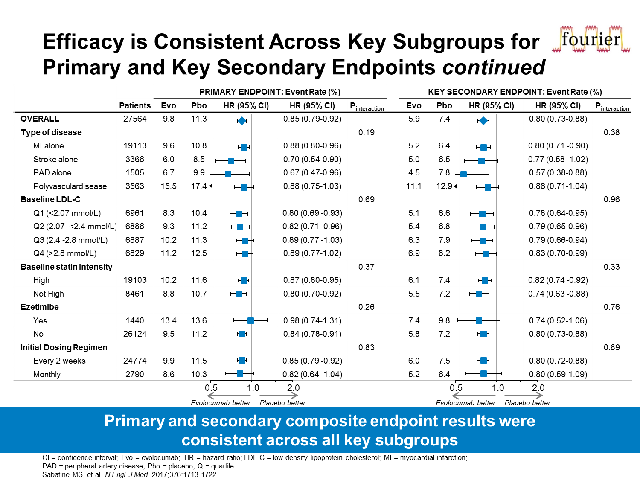
FOURIER
Efficacy is consistent Across Key Subgroups for Primary and Key Secondary Endpoints
Primary and secondary composite endpoint results were consistent across all key subgroups
CI: confidence interval; Evo: evolocumab; HR: hazard ratio; LDL-C: low-density lipoprotein cholesterol; MI: myocardial infarction; PAD: peripheral artery disease; Pbo: placebo; Q: quartile Sabatine MS, et al . N Engl J Med 2017; 376:1713-1722
Notes:
Notes:

Slide 37
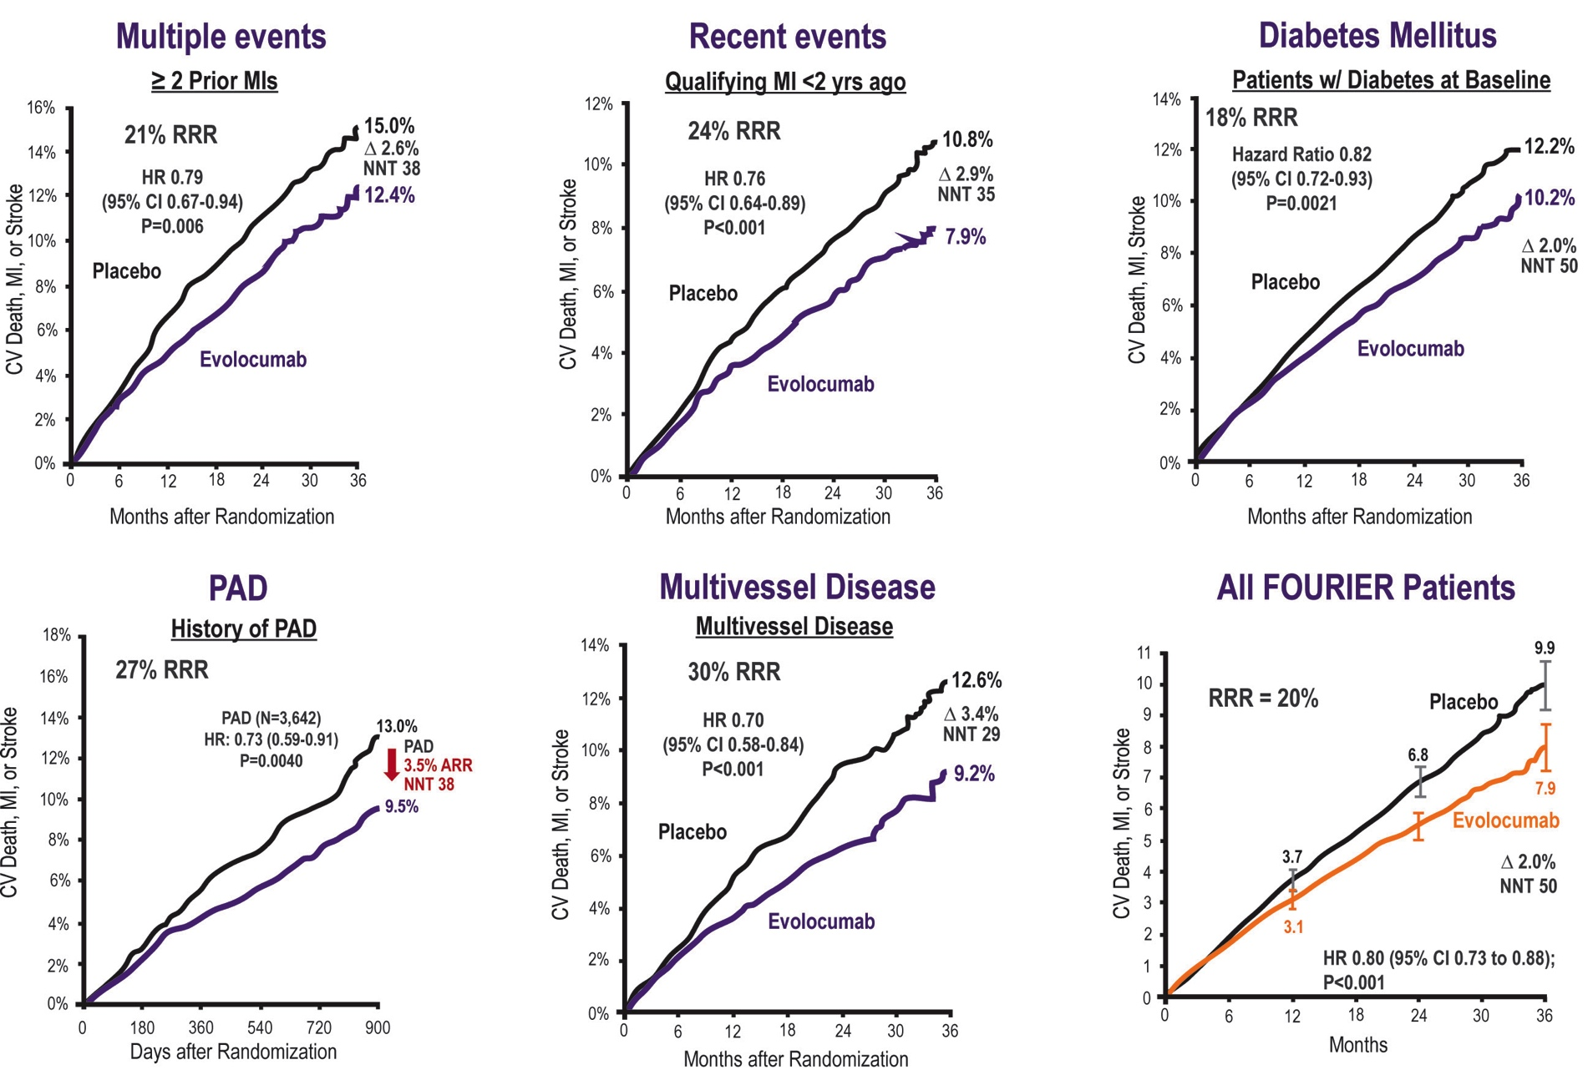
FOURIER Multiple High-Risk Patient Population Sub-Analysis
Sabatine MS, et al . AHA 2017 Poster
Notes:
Notes:

Slide 38
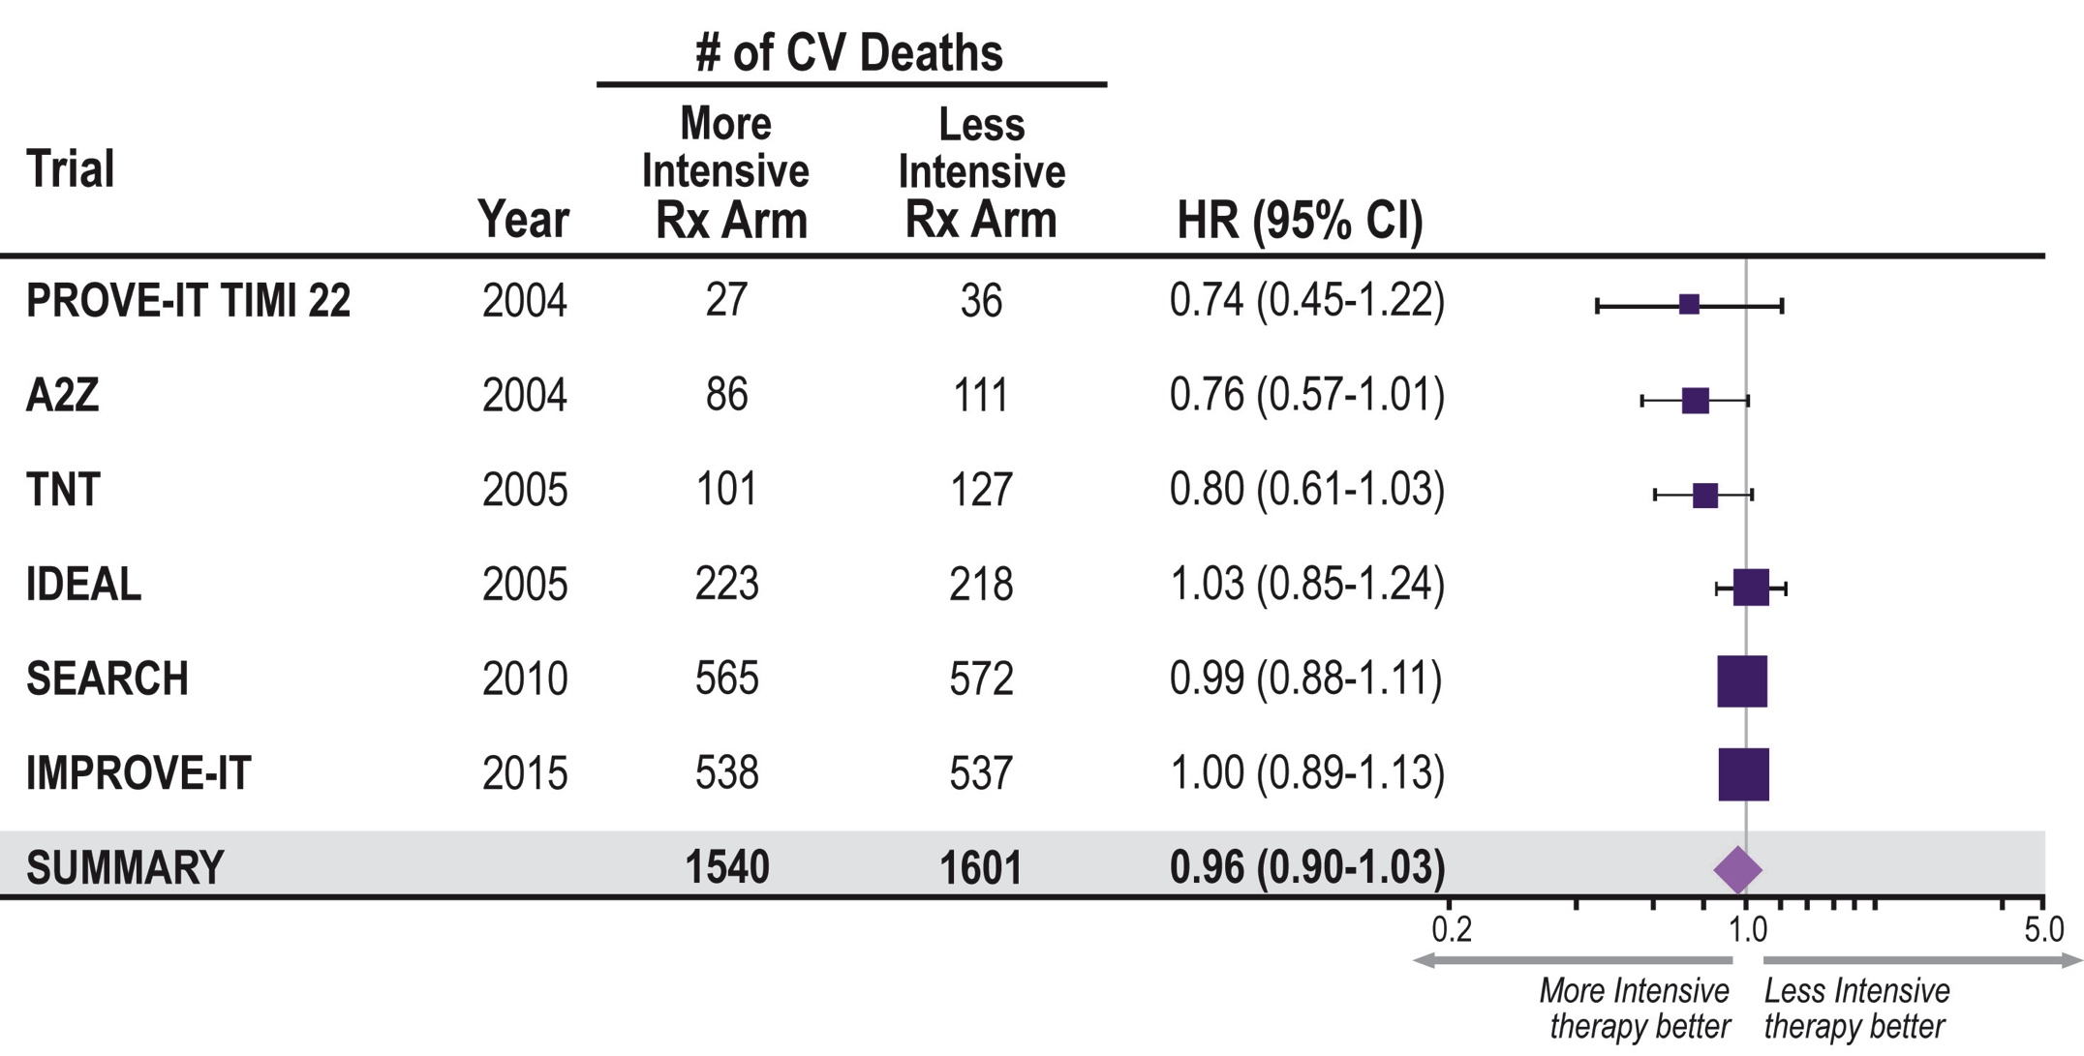
More Intensive LDL-C Lowering and CV Mortality
1. Cannon CP, et al. N Engl J Med. 2004;350:1495-1504. 2. de Lemos JA, JAMA 2004;292:1307-1316. 3. LaRosa JC, et al. N Engl J Med. 2005;352:1425-1435. 4. Pederson TR, et al. JAMA. 2005; 294:2437-2445. 5. Search Collaborative Group. Lancet 2010; 376: 1658–69. 6. Cannon CP, et al. N Engl J Med. 2015;372:2387-2397. 7. Sabatine MS, et al. American College of Cardiology – 66th Annual Scientific Session Late-Breaking Clinical Trial. Washington, D.C. March 17, 2017.
Notes:
Notes:

Slide 39
With Respect to Safety of PCSK9 Inhibitors, Which is True?
Please select from one of the available options
There is concern about neuro-cognitive AE
There is concern about myalgia
No significant adverse events have been demonstrated
The use of vitamin D supplementation is recommended
Notes:
Correct Answer: No significant adverse events have been demonstrated

Slide 40
FOURIER
Adverse Events and Laboratory Measures in the Safety Population*
Adverse Events, n (%) | Evolocumab (N = 13,769) | Placebo (N = 13,756)
Injection-site reaction** | 296 (2.1) | 219 (1.6)
Allergic reactions | 420 (3.1) | 393 (2.9)
Muscle-related event | 682 (5.0) | 656 (4.8)
Rhabdomyolysis | 8 (0.1) | 11 (0.1)
Cataract | 228 (1.7) | 242 (1.8)
Adjudicated case of new-onset diabetes† | 677 (8.1) | 644 (7.7)
Neurocognitive event | 217 (1.6) | 202 (1.5)
Laboratory results - n/total n (%)
Aminotransferase >3x ULN | 240/13,543 (1.8) | 242/13,523 (1.8)
Creatinine kinase >5x ULN | 95/13,543 (0.7) | 99/13,523 (0.7)
*Safety evaluations included all randomized patients who received at least one dose of study treatment and for whom post-dose data are available. **The between-group difference was nominally significant (P<0.001). †HR 1.05 (95% CI 0.94-1.17); denominators of 8337 (evolocumab) and 8339 (placebo) because patients with prevalent diabetes at the start of the trial were excluded.
Incidence of neurocognitive events, cataracts, and new-onset diabetes were similar between the two arms
Post-baseline anti-evolocumab antibodies were detected in 0.3%, with no neutralizing antibodies detected
ULN = Upper Limit of Normal Sabatine MS, et al . NEJM. [published online ahead of print March 17, 2017]. doi: 10.1056/NEJMoa1615664

Slide 41
EBBINGHAUS
Evaluating PCSK9 Binding Antibody Influence On Cognitive Health in High Cardiovascular Risk Subject
Purpose: Evaluate change over time in neurocognitive testing in subjects receiving statin therapy in combination with evolocumab, compared with subjects receiving statin therapy in combination with placebo
Subset of Patients Randomized in FOURIER
N = 1,972
Inclusion Criteria:
Male or female ≥ 40 to ≤ 85 years old
Randomized into FOURIER
Exclusion Criteria:
Current or known past diagnosis of dementia or mild cognitive impairment
Randomization 1:1
Evolocumab SC
Q2W or QM
+ effective statin dose
Total Follow-Up 4 years
Results before 2017
Placebo
Q2W or QM
+ effective statin dose
Primary endpoint: Mean change from baseline over time in Spatial Working Memory index of executive function
Secondary endpoints: Mean change from baseline over time in Spatial Working Memory between-errors score, mean change from baseline over time in paired associated learning total errors adjusted, and mean change from baseline over time in reaction time median 5-choice reaction time
Q2W, every 2 weeks; QM, every month; SC, subcutaneous.
ClinicalTrials.gov. https://clinicaltrials.gov/ct2/show/NCT022007634. Accesses February 2, 2016
Notes:
Notes:

Slide 42
EBBINGHAUS
Results and Conclusions
In patients with known cardiovascular disease on background statin followed for 20 months
No differences between evolocumab vs placebo
A battery of cognitive tests
Patient-reported everyday cognition
Adverse cognitive events reported by MD
No evidence of differences in cognitive tests by achieved nadir LDL-C, even 0.65 mmol/L

Slide 43
ODYSSEY Outcomes Study Design
Post-ACS (4-52 weeks) patients¹ age ≥40 yrs (n~18,000)
with LDL-C ≥1.81 mmol/L, or ApoB ≥ 0.8 g/L, or Non-HDL-C ≥ 2.59 mmol/L
despite high-intensity (or maximally tolerated) statin (atorvastatin 40-80 mg or rosuvastatin 20-40 mg/daily) x ≥2 wks ± other lipid-modifying therapy (e.g., ezetimibe, fenofibrate)²
Randomization³
Alirocumab 75 mg SC Q2wks x 2 months → 150 mg SC Q2wks based upon Month 1
LDL-C ≥ 1.3 mmol/L⁴ with dose titrated to maintain LDL-C in the 0.6-1.3 mmol/L target range
Placebo SC Q2wks
Primary Endpoint: Time to first CHD death/non-fatal MI/fatal and non-fatal ischemic stroke/unstable angina requiring hospitalization
Follow-Up: Minimum 24 months or target number of events (~1600) → estimated 11.4% rate at 4 yrs, 15% risk reduction; 90% power, 1-sided p=0.025, 1% lost
¹ Elevated troponin or CK-MB or resting ECG changes + obstructive coronary disease (new/presumed new ischemia/infarction
by perfusion imaging, regional wall motion abnormality, coronary stenosis ≥70% by angiography)
² Key exclusion criteria: Uncontrolled hypertension; NYHA III-IV or LVEF<25%;
prior hemorrhagic stroke; TG>4.52 mmol/L; hepatitis; eGFR<30 ml/min
² Following ≥2 wk (+ 5 days) run-in period with placebo (1 mL volume in an autoinjector) SC Q2wks
³ Titration downwards for very low LDL
Schwartz et al Am Heart J 2014;168:682-689.e1

Slide 44
ODYSSEY Outcomes
A Target Range for LDL-C
An attempt was made to maximize the number of patients in the target range and minimize the number below target by blindly titrating alirocumab (75 or 150 mg SC Q2W) or blindly switching to placebo.
Target range
Undesirably high
baseline range
Below target
Acceptable range
Alirocumab
0
0.4
0.6
1.3
1.8
LDL-C (mmol/L)
Schwartz GG, et al. Am Heart J 2014;168:682-689.e1.
Notes:
Notes:
First view: Right-hand red zone to indicate patients qualifying for study with LDL-C “undesirably high” (i.e., >/=1.8 mmol/L)
Second view: Alirocumab dose is blindly adjusted to maximize the number of patients in a low but physiologic range of LDL-C (i.e., 0.6-1.3 mmol/L)
Third view: Alirocumab dose is also blindly adjusted to minimize patients with persistently very low levels of LDL-C (i.e., <0.4 mmol/L)

Slide 45
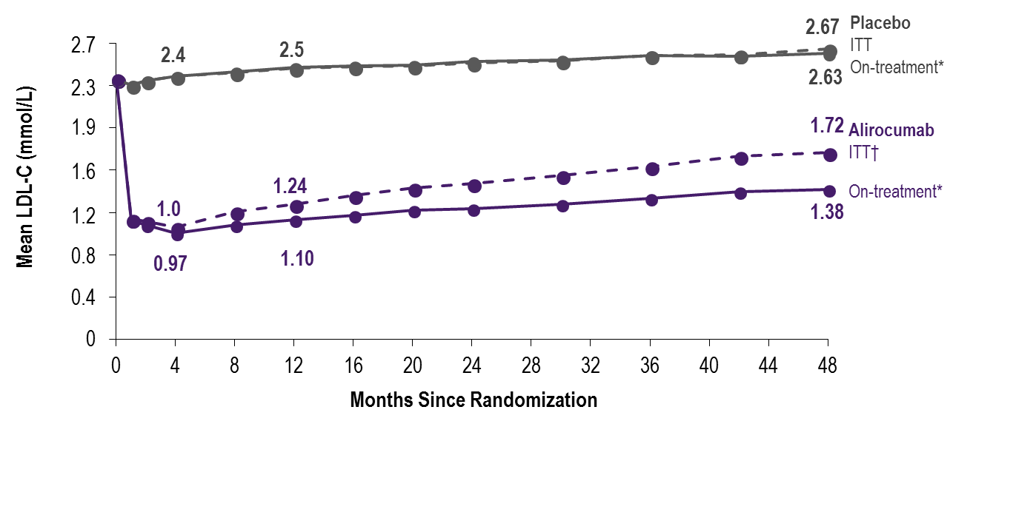
ODYSSEY Outcomes
LDL-C: ITT and On-Treatment Analyses
*Excludes LDL-C values after premature treatment discontinuation or blinded switch to placebo
†All LDL-C values, including those after premature treatment discontinuation, blinded down titration, or blinded switch to placebo
Steg G. et al; On behalf of the ODYSSEY OUTCOMES Investigators and Committees - American College of Cardiology – 67th Scientific Sessions - March 10, 2018
Notes:
Notes
:
Includes all LDL-C values, regardless of blinded down titration or switch to placebo or premature treatment discontinuation

Slide 46
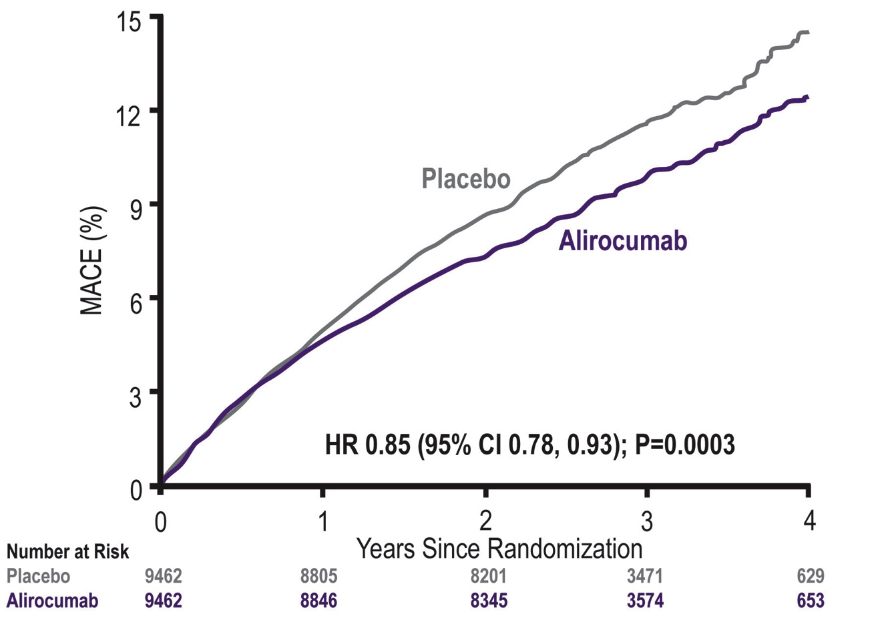
ODYSSEY Outcomes
Primary Efficacy Endpoint: MACE
MACE: CHD death, non-fatal MI, ischemic stroke, or unstable angina requiring hospitalization
ARR* 1.6%
*Based on cumulative incidence
Steg G. et al; On behalf of the ODYSSEY OUTCOMES Investigators and Committees - American College of Cardiology – 67th Scientific Sessions - March 10, 2018
Notes:
Notes

Slide 47
ODYSSEY Outcomes
Primary Efficacy Endpoint and Components
Endpoint, n (%) | Alirocumab (N=9462) | Placebo (N=9462) | HR (95% CI) | Log-rank P-value
MACE | 903 (9.5) | 1052 (11.1) | 0.85 (0.78, 0.93) | 0.0003
CHD death | 205 (2.2) | 222 (2.3) | 0.92 (0.76, 1.11) | 0.38
Non-fatal MI | 626 (6.6) | 722 (7.6) | 0.86 (0.77, 0.96) | 0.006
Ischemic stroke | 111 (1.2) | 152 (1.6) | 0.73 (0.57, 0.93) | 0.01
Unstable angina | 37 (0.4) | 60 (0.6) | 0.61 (0.41, 0.92) | 0.02
Steg G. et al; On behalf of the ODYSSEY OUTCOMES Investigators and Committees - American College of Cardiology – 67th Scientific Sessions - March 10, 2018
Notes:
Notes
:

Slide 48
ODYSSEY Outcomes
Main Secondary Efficacy Endpoints - Hierarchical Testing
Endpoint, n (%) | Alirocumab (N=9462) | Placebo (N=9462) | HR (95% CI) | Log-rank P-value
CHD event | 1199 (12.7) | 1349 (14.3) | 0.88 (0.81, 0.95) | 0.001
Major CHD event | 793 (8.4) | 899 (9.5) | 0.88 (0.80, 0.96) | 0.006
CV event | 1301 (13.7) | 1474 (15.6) | 0.87 (0.81, 0.94) | 0.0003
Death, MI, ischemic stroke | 973 (10.3) | 1126 (11.9) | 0.86 (0.79, 0.93) | 0.0003
CHD death | 205 (2.2) | 222 (2.3) | 0.92 (0.76, 1.11) | 0.38
CV death | 240 (2.5) | 271 (2.9) | 0.88 (0.74, 1.05) | 0.15
All-cause death | 334 (3.5) | 392 (4.1) | 0.85 (0.73, 0.98) | 0.026*
*Nominal P-value
Steg G. et al; On behalf of the ODYSSEY OUTCOMES Investigators and Committees - American College of Cardiology – 67th Scientific Sessions - March 10, 2018
Notes:
Notes
:

Slide 49
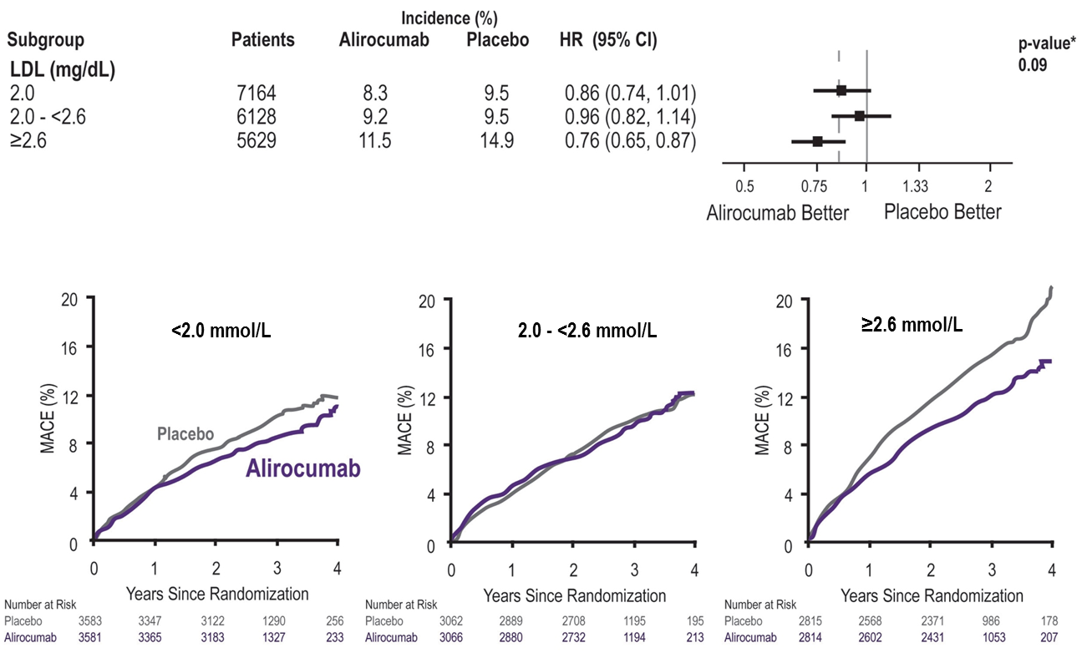
ODYSSEY Outcomes
Primary Efficacy in Main Prespecified Subgroups
*P-values for interaction
Steg G. et al; On behalf of the ODYSSEY OUTCOMES Investigators and Committees - American College of Cardiology – 67th Scientific Sessions - March 10, 2018
Notes:
Notes

Slide 50
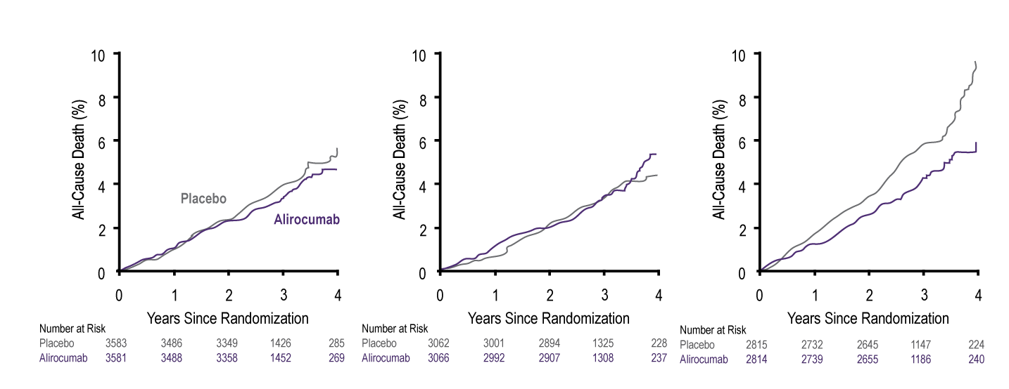
ODYSSEY Outcomes
Post Hoc Analysis: All-Cause Death by Baseline LDL-C Subgroups
2.0 mmol/L
2.0 to < 2.6 mmol/L
≥ 2.6 mmol/L
HR 0.89 (95% CI 0.69, 1.14)
HR 1.03 (95% CI 0.78, 1.36)
HR 0.71 (95% CI 0.56, 0.90)
ARR* 1.7%
P_{interaction}= 0.12
*Based on cumulative incidence
ARR = Absolute Risk Reduction
Steg G. et al; On behalf of the ODYSSEY OUTCOMES Investigators and Committees - American College of Cardiology – 67th Scientific Sessions - March 10, 2018
Notes:
Notes

Slide 51
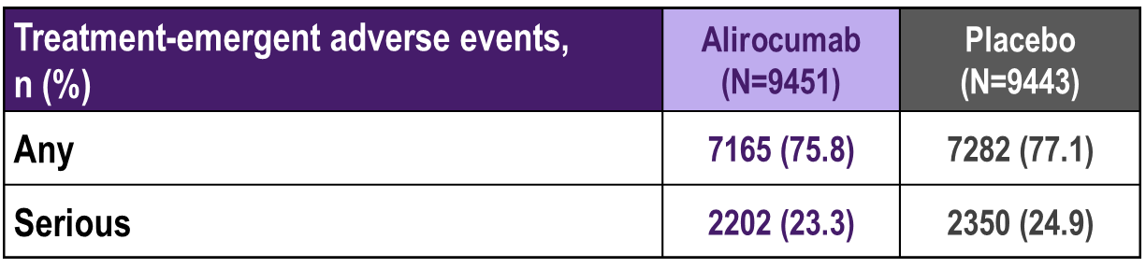
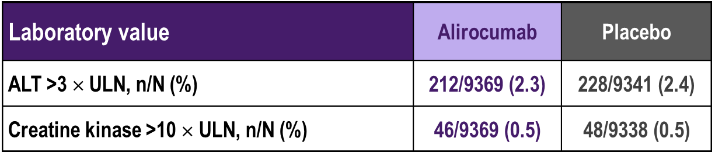
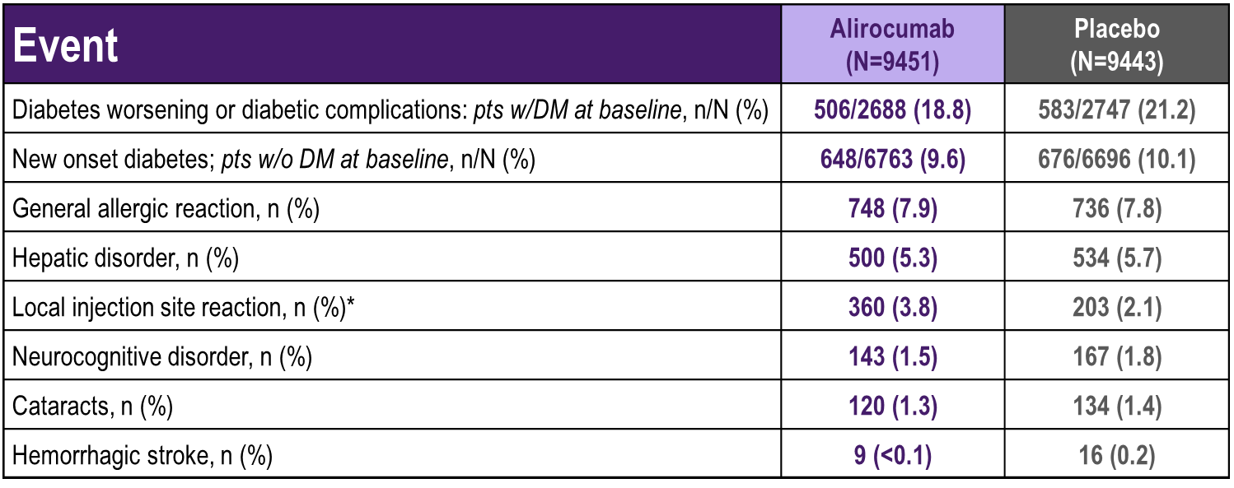
ODYSSEY Outcomes
Safety
Steg G. et al; On behalf of the ODYSSEY OUTCOMES Investigators and Committees - American College of Cardiology – 67th Scientific Sessions - March 10, 2018
Notes:
Notes
:

Slide 52
ODYSSEY Outcomes
Conclusions
Compared with placebo in patients with recent ACS, alirocumab 75 or 150 mg subcutaneous Q2W targeting LDL-C levels 0.6-1.3 mmol/L, and allowing levels as low as 0.4 mmol/L:
Reduced MACE, MI, and ischemic stroke
Was associated with a lower rate of all-cause death
Was safe and well-tolerated over the duration of the trial
Steg G. et al; On behalf of the ODYSSEY OUTCOMES Investigators and Committees - American College of Cardiology – 67th Scientific Sessions - March 10, 2018
Notes:
Notes
:

Slide 53

2016 CCS Lipid Guidelines Recommend: Targeting Lower LDL-C to Lower the Risk for CV Events
TREATMENT TARGETS:
STATIN INDICATED CONDITIONS
LDL-C consistently <2.0 mmol/L or >50% reduction
Consider <1.8 mmol/L in patients with clinical atherosclerosis
Apo B ≤0.80 g/L or non-HDL-C ≤2.6 mmol/L can be considered as alternative treatment targets
(those who will benefit the most):
Clinical atherosclerosis*
Abdominal aortic aneurysm
Most diabetes mellitus
CKD (age >50 years)
LDL-C ≥5.0 mmol/L
*Clinical atherosclerosis, i.e., previous MI, or coronary revascularization by PCI or CABG surgery, other arterial revascularization procedures, angina pectoris, cerebrovascular disease including TIA, or peripheral arterial disease (claudication and/or ABI <0.9)
ABI, ankle brachial index; Apo B, apolipoprotein B; CABG, coronary artery bypass graft surgery; CCS, Canadian Cardiovascular Society; CKD, chronic kidney disease; CV, cardiovascular; HDL-C, high-density lipoprotein cholesterol; LDL-C, low-density lipoprotein cholesterol; MI, myocardial infarction; PCI, percutaneous coronary intervention; TIA, transient ischemic attack.
Anderson TJ et al. 2016;32:1263-1282
Notes:
Notes
:
Fortunately, we have conducted many studies such as TNT, PROVE-IT TIMI 22, JUPITER and now IMPROVE-IT where patients have achieved very low levels of LDL-C without major safety concerns emerging.

Slide 54

Beyond Statin Drugs for ASCVD Prevention
We recommend ezetimibe as second-line therapy to lower LDL-C in patients with clinical cardiovascular disease if targets are not reached on maximally tolerated statin therapy. (Strong Recommendation, High Quality evidence)
We recommend that niacin not be added to statin therapy for CVD prevention in patients who have achieved LDL-C targets. (Strong Recommendation, High Quality Evidence)
We do not recommend the addition of fibrates to statin therapy for CVD event prevention in patients who have achieved LDL-C targets. (Strong recommendation, High Quality evidence). Values and preferences: In sub-group analysis, patients with elevated triglycerides and low HDL-C may benefit from fibrate therapy.
Anderson et al. 2016 Canadian Cardiovascular Society Guidelines for the Management of Dyslipidemia for the Prevention of Cardiovascular Disease in the Adult Canadian Journal of Cardiology 2016;32:1263-1282
Notes:
Notes

Slide 55
Recommendations for PCSK9i in FH and ASCVD
We suggest the use of PCSK9 inhibitors (evolocumab, alirocumab) to lower LDL-C for patients with heterozygous familial hypercholesterolemia whose LDL-C remains above target despite maximally tolerated statin therapy (Conditional recommendation, moderate quality evidence)
We suggest that PCSK9 inhibitors be considered to lower LDL-C for patients with atherosclerotic cardiovascular disease in those not at LDL-C goal despite maximally tolerated statin +/- ezetimibe therapy (Conditional recommendation, moderate quality evidence)
We suggest that evolocumab be added to background therapy in patients with homozygous familial hypercholesterolemia and continued if LDL-C lowering is documented (Conditional recommendation, moderate quality evidence)
Anderson et al. 2016 Canadian Cardiovascular Society Guidelines for the Management of Dyslipidemia for the Prevention of Cardiovascular Disease in the Adult Canadian Journal of Cardiology 2016;32:1263-1282
Notes:
Notes

Slide 56
PCSK9 Inhibitors and Their Indications
Alirocumab¹
Adjunct to diet and maximally tolerated statin therapy where additional LDL-C lowering is needed in adults with
HeFH
Clinical ASCV
Evolocumab²
Adjunct to diet and maximally tolerated statin therapy where additional LDL-C lowering is needed in adults with
HeFH
Clinical ASCVD
Adjunct to diet and other LDL-C lowering therapies in persons ≥12 years with HoFH who require additional LDL-C lowering
ASCVD, atherosclerotic cardiovascular disease; HeFH, heterozygous familial hypercholesterolemia; HoFH, homozygous familial hypercholesterolemia; LDL-C, low density lipoprotein cholesterol; PCSK9, proprotein convertase subtilisin kexin type 9.
1. Praluent Canadian Product Monograph, April 11, 2016; 2. IRepatha Canadian Product Monograph, June 29 2016;
Notes:
Notes

Slide 57
Summary
Despite clear guidelines and widespread use of statin therapy, almost half of high risk patients do not achieve the recommended target for LDL-C < 2.0 mmol/L
Challenges in reaching the LDL-C target include
Wide range of LDL-C lowering seen in patients
Side effects, particularly myalgia
Limited efficacy of statin therapy in lowering LDL-C
There is a need for LDL-C lowering beyond statin therapy
The data from clinical trials with PCSK9 inhibition demonstrate efficacy and safety of LDL-C lowering by an additional 60% on top of statin ± ezetimibe therapy resulting in further reductions in MACE
MACE = Major Adverse Cardiovascular Events
Notes:
Notes

